Slide 1
Digital Portfolio
STUDENT NAME: Hemalatha.M
REGISTER NO AND NMID: 2BD3D6E85482C31AA0E4F7E5B524DD4B /astvu21021024u18027
DEPARTMENT: Bsc computer science.
COLLEGE: Sri Akilandeswari Womens college-Wandiwash.

Slide 2
PROJECT TITLE
Student Digital Portfolio using HTML , CSS, Java Script.

Slide 3


AGENDA
Problem Statement
Project Overview
End Users
Tools and Technologies
Portfolio design and Layout
Features and Functionality
Results and Screenshots
Conclusion
Github Link
3/21/2024 Annual Review

Slide 4

PROBLEM STATEMENT
Many fresh graduates and developers struggle to showcase their skills and projects effectively to recruiters and clients.
Without a personal portfolio website, their work often remains unnoticed.
To solve this, a clean and professional portfolio website is needed to highlight skills, display projects, and provide easy contact options.

Slide 5

PROJECT OVERVIEW
The website includes sections such as About Me, Skills, Projects, and Contact, providing an interactive and user-friendly platform to present my work.
It highlights my technical abilities, problem-solving skills, and achievements, while also offering an easy way for recruiters or collaborators to reach me.

Slide 6

WHO ARE THE END USERS?
Recruiters / Hiring Managers – to evaluate your skills and projects for job opportunities.
Potential Clients – who may want to hire you for freelance or project work.
Collaborators / Peers – other developers or learners interested in connecting or working with you.
Teachers / Mentors – to review your progress and projects.

Slide 7

TOOLS AND TECHNIQUES
HTML – for structure of the website.
CSS – for styling and layout.
JavaScript – for interactivity and dynamic features.
Responsive Design – to make it work on mobile, tablet, and desktop.

Slide 8
POTFOLIO DESIGN AND LAYOUT
Header with navigation links (About, Projects, Contact).
About Me section introducing your skills and interests.
Projects section with project cards showing title and description.
Contact form for name, email, and message submission.
Clean and minimal layout with clear sections for easy navigation.
8

Slide 9
FEATURES AND FUNCTIONALITY
About Section – quick introduction and skills overview.
Projects Section – displays your main projects with details.
Contact Form – allows users to send messages directly.
Navigation Bar – easy access to different sections.
Responsive Layout – works on mobile, tablet, and desktop.

Slide 10
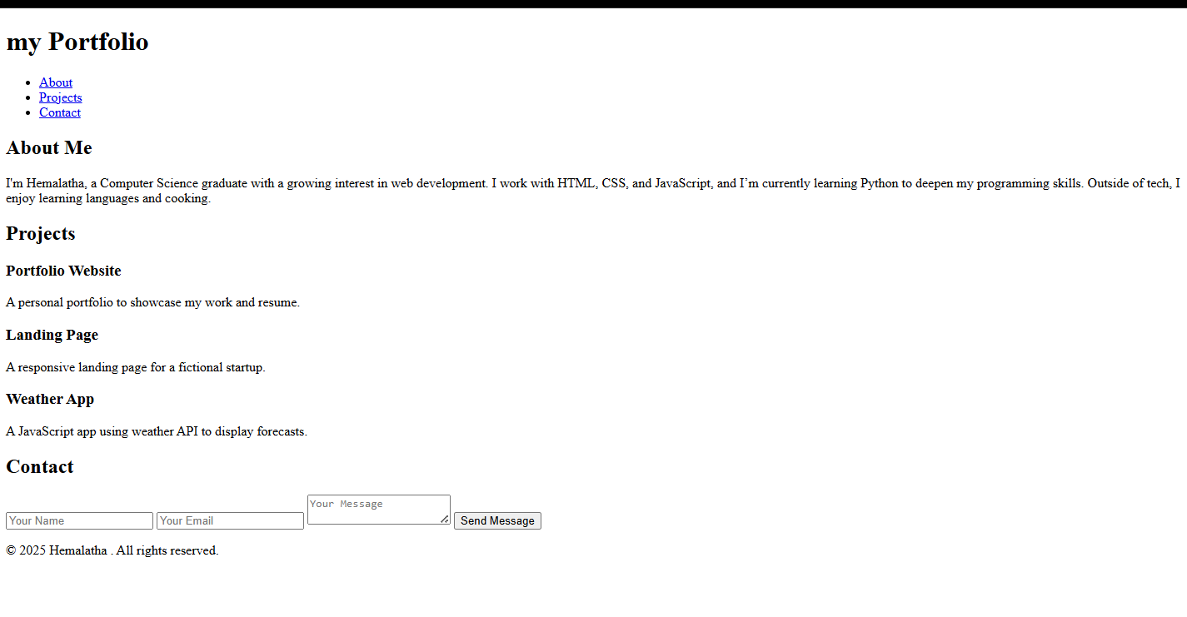
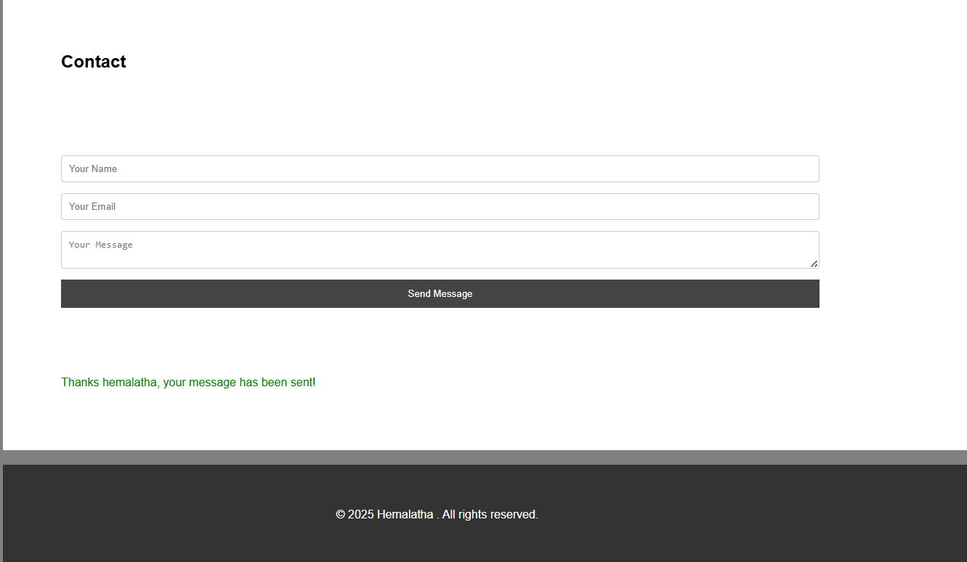

RESULTS AND SCREENSHOTS
1) Screenshots of each section.
2) Before vs After (plain HTML--> with CSS & JS).
3/21/2024 Annual Review
10

Slide 11
CONCLUSION
"The portfolio website provides a professional way to showcase skills, highlight projects, and connect with recruiters or clients. It is simple, user-friendly, and responsive, making it an effective tool for personal branding and career opportunities
11

Slide 12
GitHub Link:
https://github.com/cutihema1008-cell/TNSDC-FWD-Digital-Portfolio.git

